Slide 1
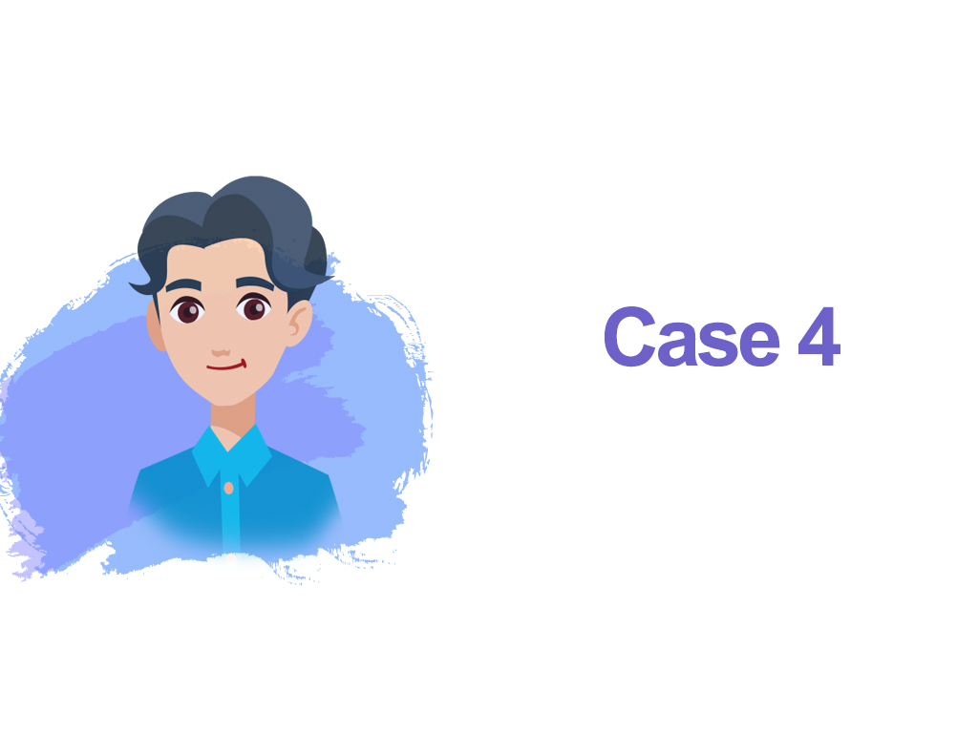

Slide 2


Giving nicknames for classmates
or teachers seems to be a collective
memory of school days
Someone this tall is a giraffe!
Fish ball, Voldemort
A perfect
name for her:
Yu Fa!

Slide 3











The feeling
about being given
a nickname or the
reasons for using
nicknames to refer
to others

Slide 4





Slide 5


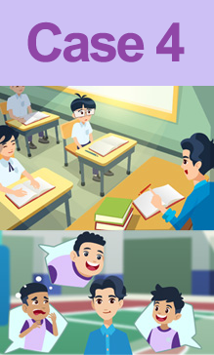
What are your thoughts on Mr Chan calling his student by the nickname?
Do you allow students to call teachers
by their nicknames? Why?

Slide 6


Review the codes in connection with teacher-student relationships

Slide 7


Care for students and be a role model
Teachers should care about and show respect for students’ feelings. Even seemingly innocuous words and deeds can inflict psychological harm on students.
Teachers should play their part as a role model by setting a good example to foster mutual respect among students and help them develop positive values.

